Slide 1
Final Presentation (WIP)
Team 2, September 2022

Slide 2
Table of Contents
Project Overview
Data Analysis
Machine Learning
Database
Dashboard

Slide 3
Project Overview

Slide 4

Topic Overview
Topic Selected: Predicting employee attrition in the healthcare industry
Reason for selecting this topic: The COVID pandemic put intense strain on the healthcare industry and led to unprecedented levels of attrition. Being able to predict which employees will attrit can help hospitals prepare for tighter staffing and lessen the impact to their patients and their bottom line. In short, this topic is very relevant and applicable to the current challenges faced in this industry.
* Attrition + attrit are used to refer to people quitting a job and the act of quitting a job, respectively

Slide 5

The Data
Source data description: The synthetic data we’re using is based on the IBM Watson dataset for attrition, but tailored to the healthcare industry.
Questions we hope to answer with the data:
1. Which factors most heavily influence a person’s likelihood of attritting?
2. What is the typical profile of a healthcare worker who is likely to attrit?

Slide 6
Data Analysis

Slide 7

Overview - Exploring the Data
Used Jupyter Notebook + Pandas to show:
DataFrame shape + structure
Missing Values
Data Types
Integer Data
Descriptive summaries for numerical columns
Informative data
String Data
Possible responses for each column of object data

Slide 8
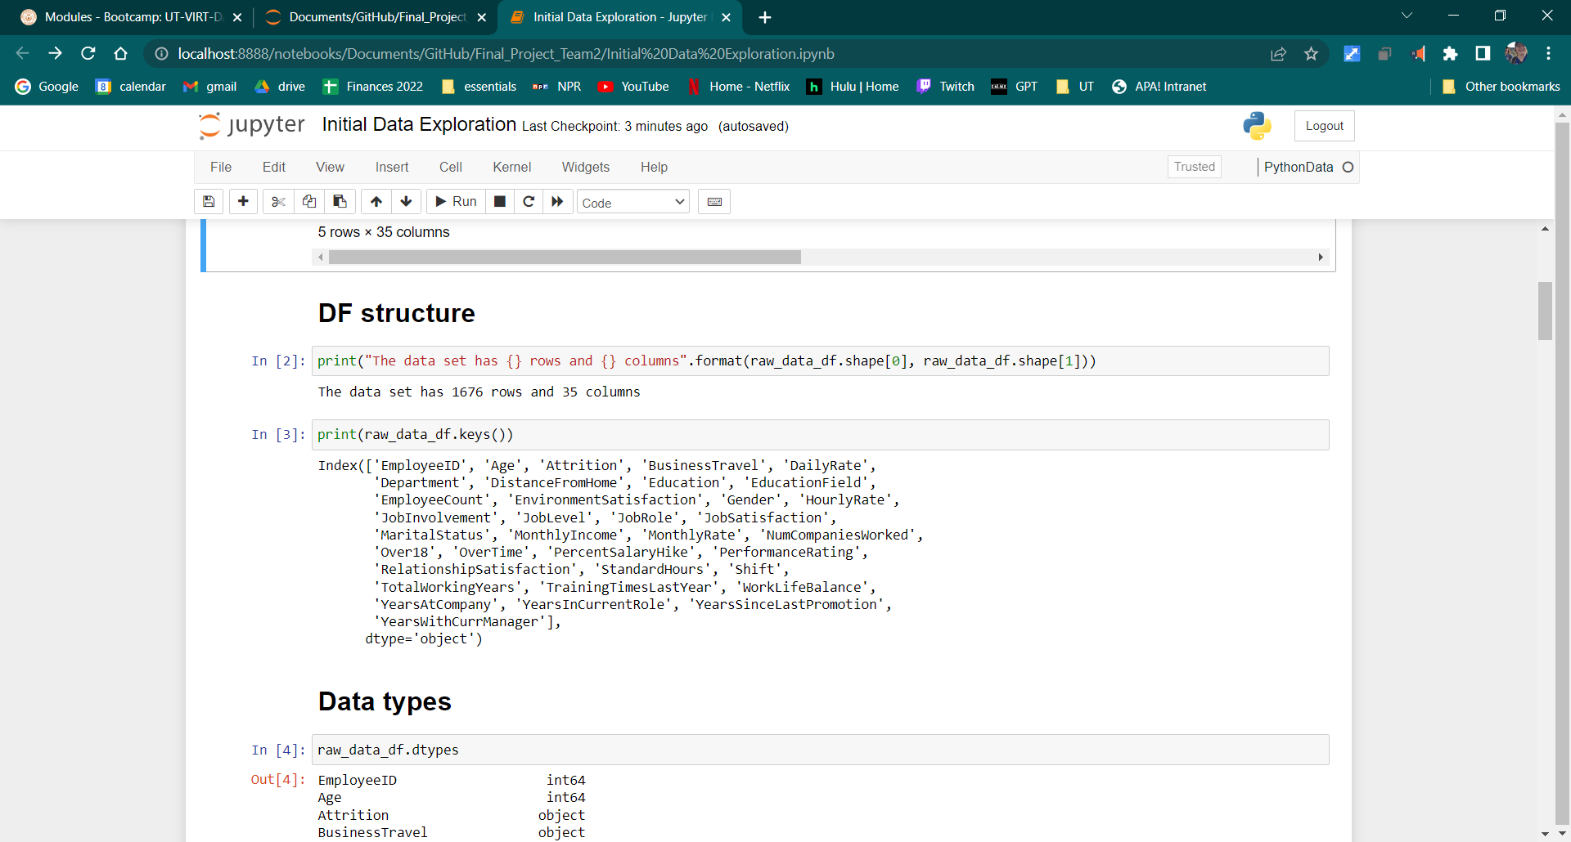
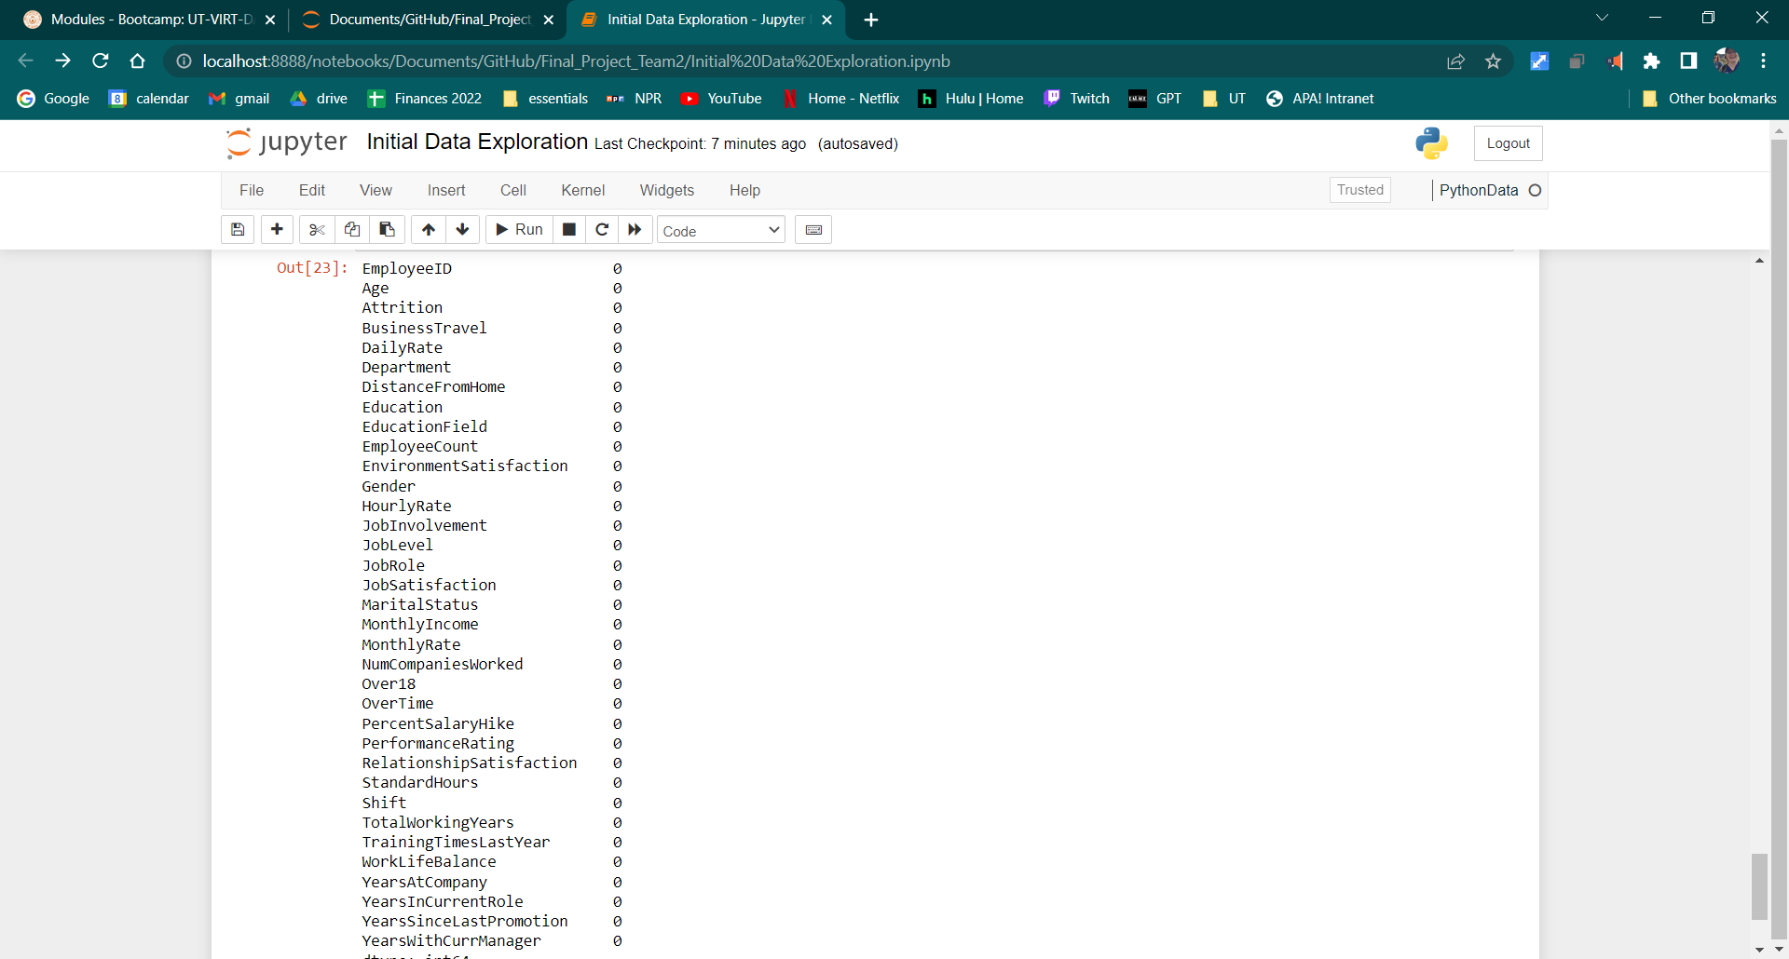
Exploring the Data
Shape
Column names & null values
DataFrame Structure:
Data divided into basic personal information, employee work history, employee current job, employee finances, employee satisfaction, and employee feedback

Slide 9
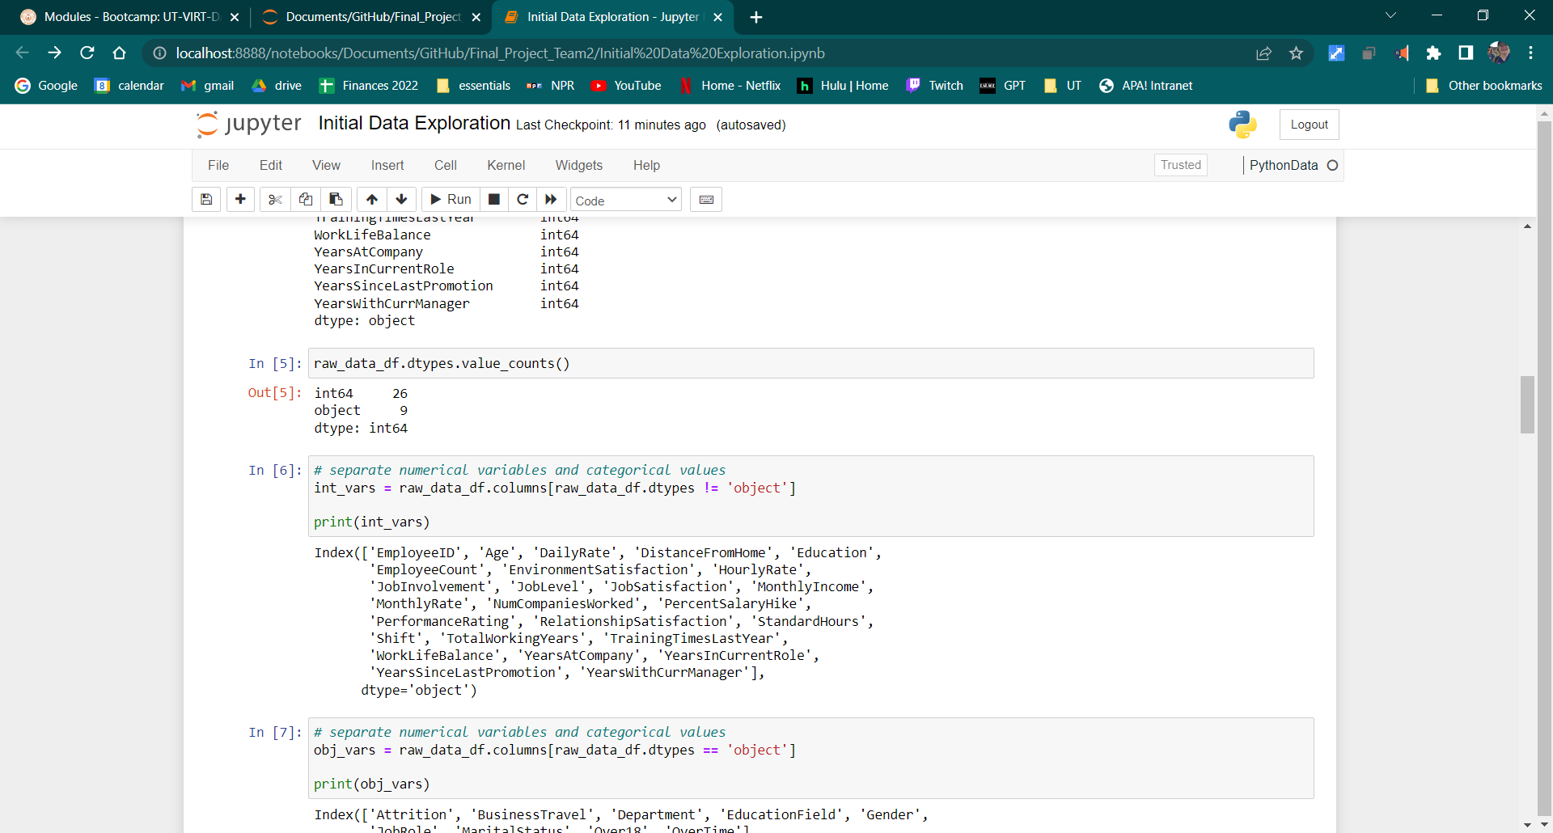
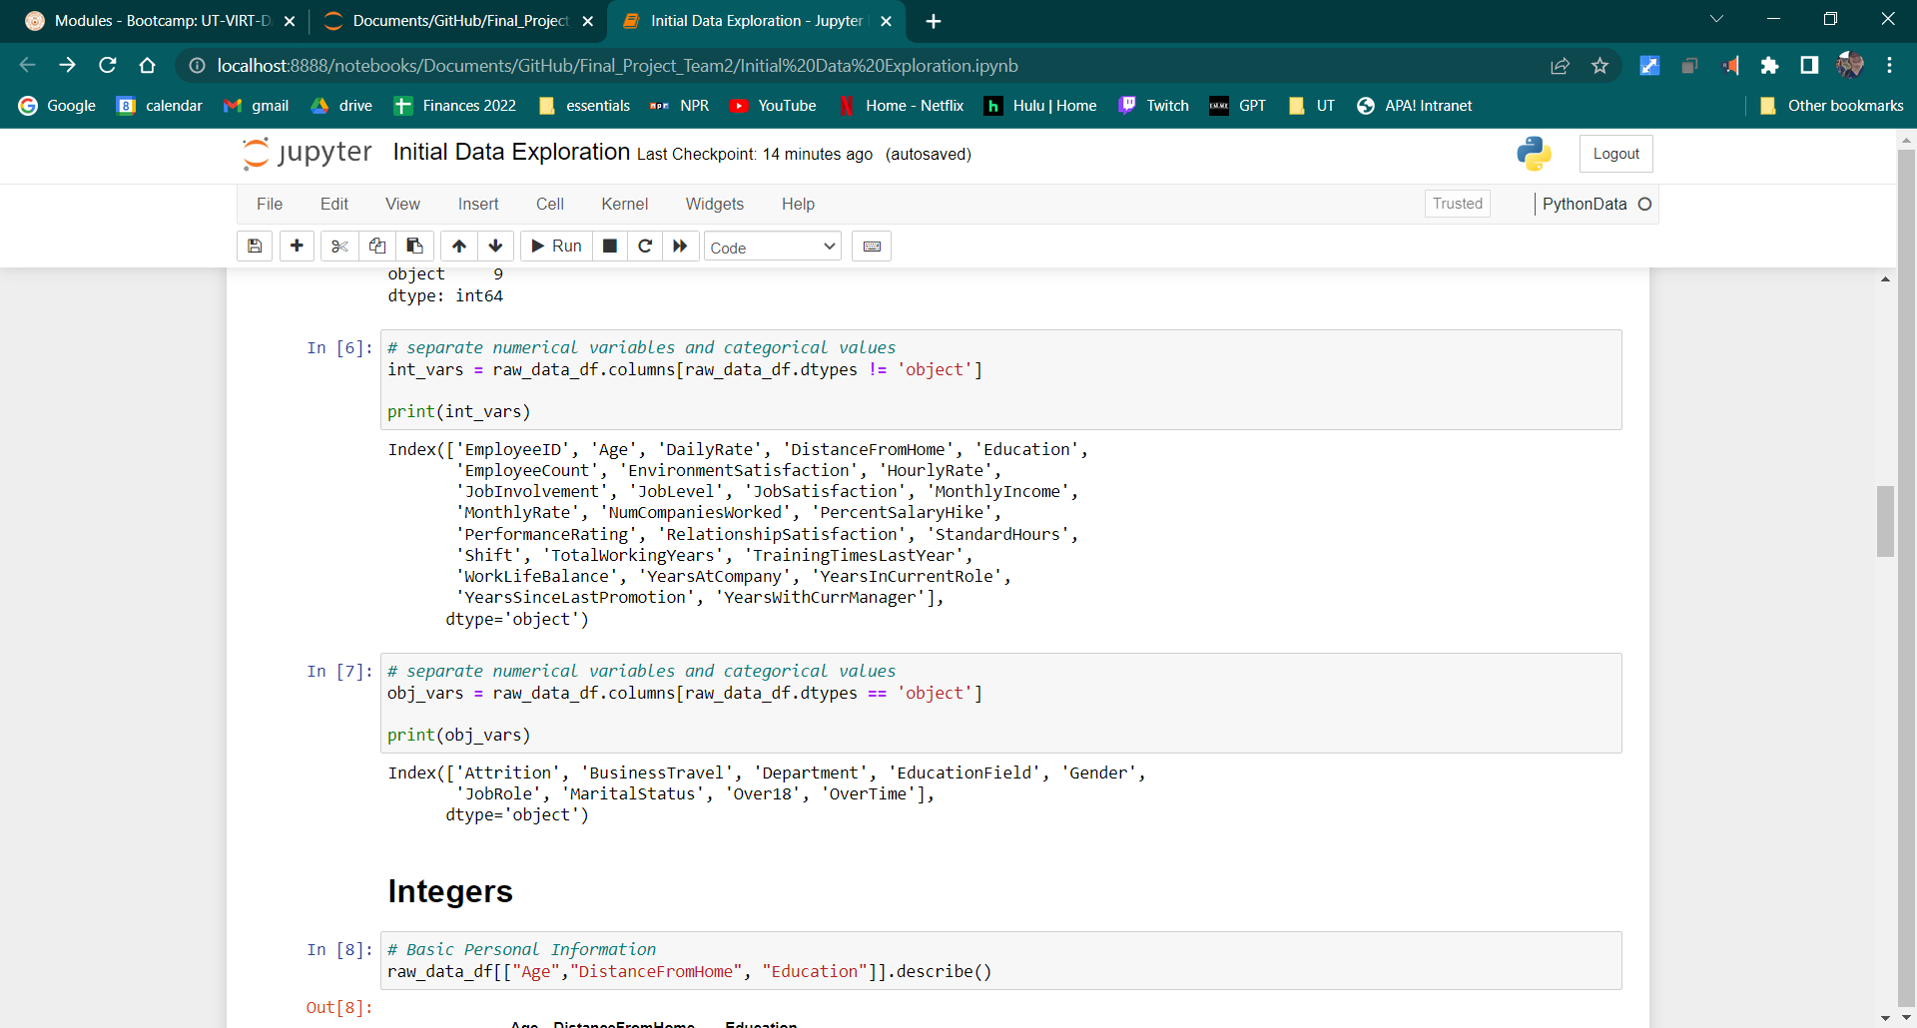
Exploring the Data
Data Type Counts
Integer Columns
Object Columns
Data Types:
Primarily int, some strings

Slide 10
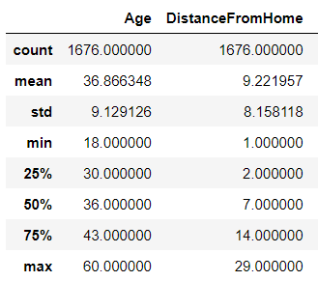
Exploring the Data
Example:
Integer Data
Descriptive data for the numerical columns
Takeaways:
EmployeeCount = 1 for all values
StandardHours = 80 for all values
DailyRate, HourlyRate, MonthlyIncome, and MonthlyRate all contain equivalent data

Slide 11
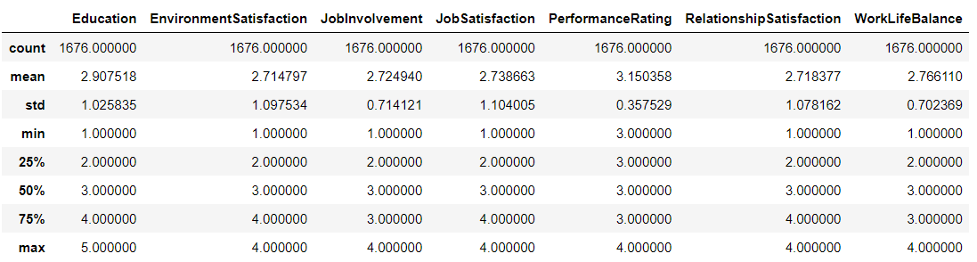
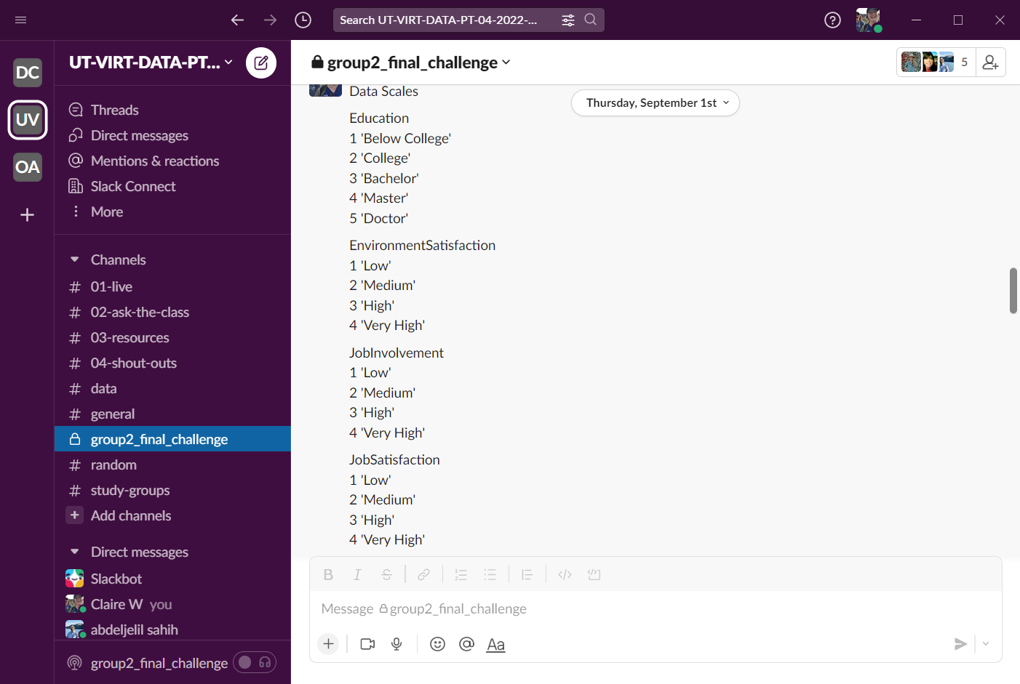
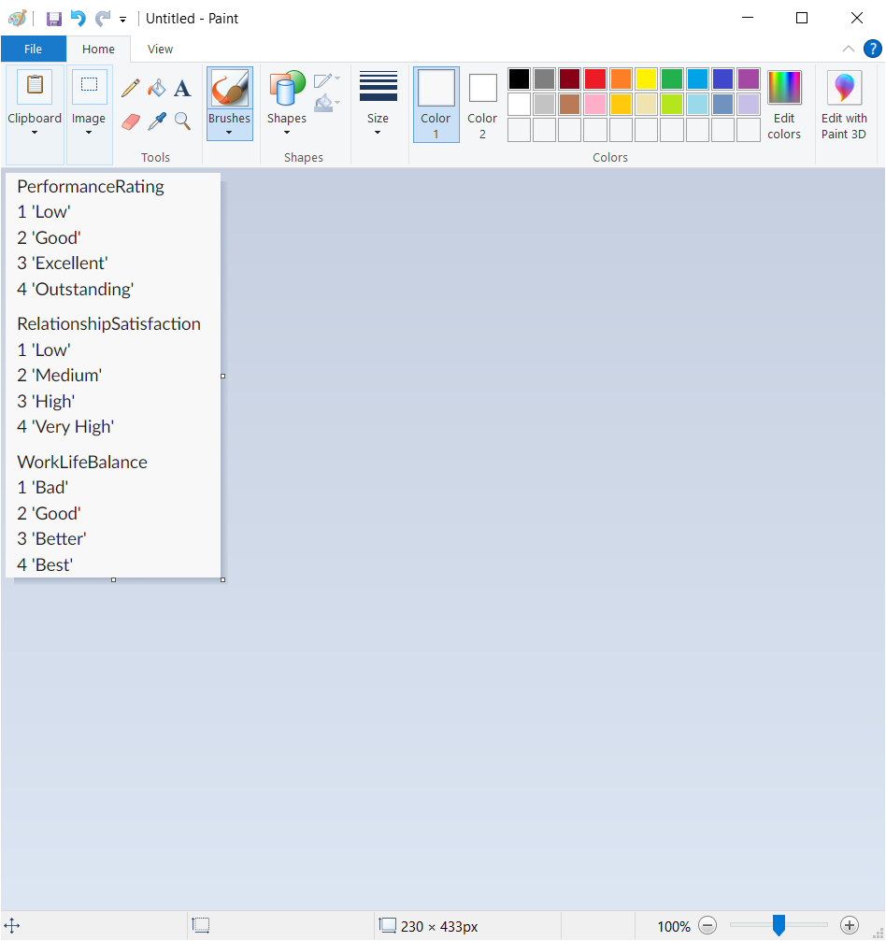
Exploring the Data
Data Scales:
Some of the columns = numerical keys used to classify categorical data
Mean + standard deviation help identify the most common responses + the spread of responses

Slide 12
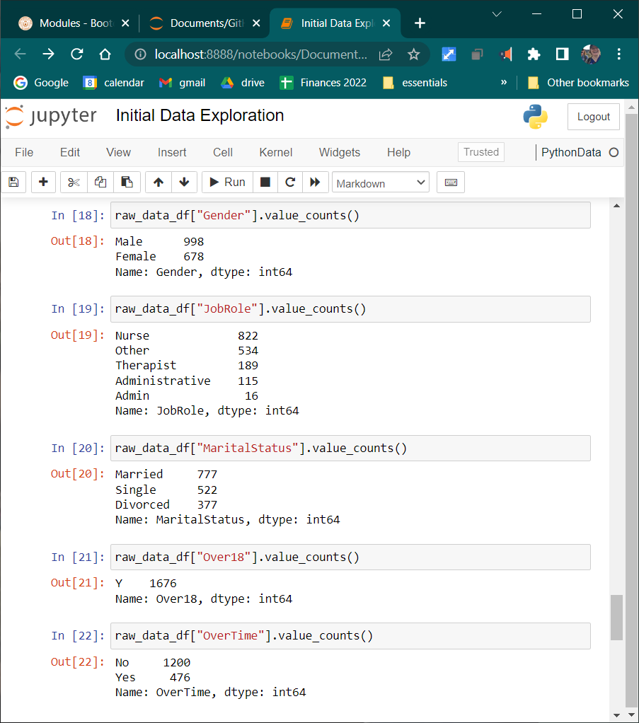
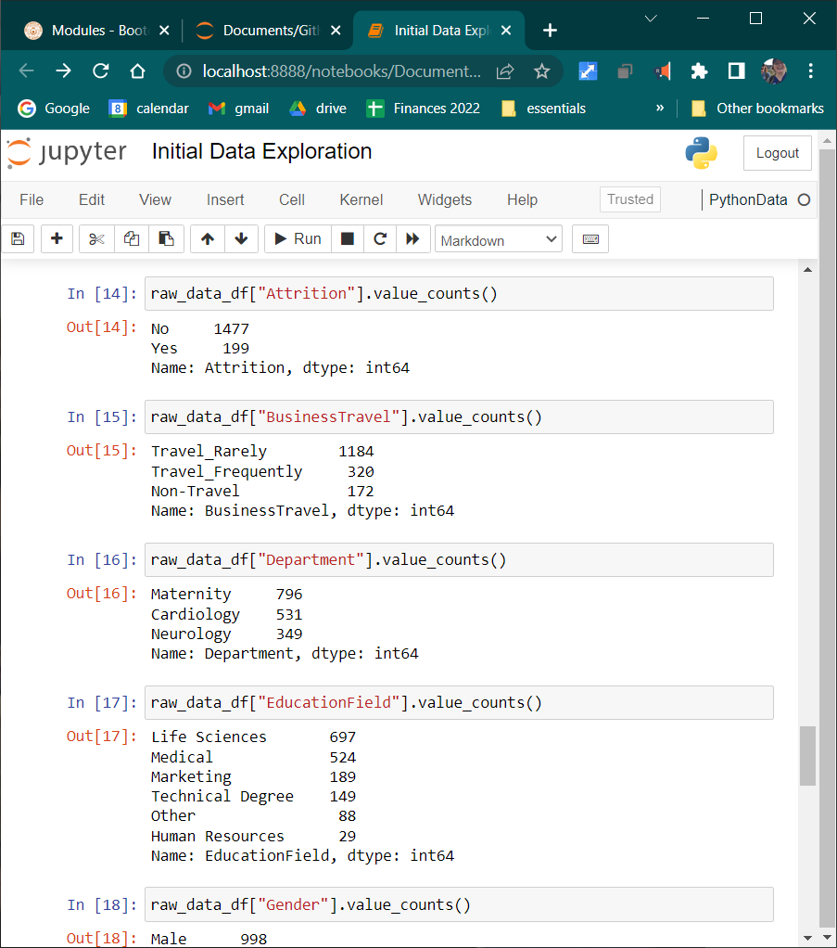
Exploring the Data
Object Type:
Columns with object data types had at most 6 different possible responses; still fairly limited response options

Slide 13
Machine Learning

Slide 14
Overview
Model Choices | Selection | Explanation
Supervised (labels) vs Unsupervised (clustering): | Supervised (logistic regression) | Data already has labels
Classification (predict discrete outcomes) vs Regression (predict continuous variables): | Classification (binary) | Used to determine discrete outcomes (attriting or not attriting)
Features vs. Target: | Features = all columns except the “Attrition” column Target = “Attrition” column | Features = variables used to make a prediction Target = predicted outcome

Slide 15
Code, v1
The Code for Section 1 lives in the “ML_Model_Draft1.ipynb” Jupyter Notebook file
Located on our repo: https://github.com/meganmcmahon/Final_Project_Team2
The current code:
Imports the dependencies
Connects to a Postgres SQL database
Loads the data as a dataframe into JN
Defines our feature + target variables
Splits the data into training + testing variables
Creates + trains our model
Prints our prediction results in a decision matrix

Slide 16
Limitations + Benefits of Logistic Regression
Explanation of model choice: We chose a supervised logistic regression model because our data already has labels (column names) and we are simply looking to perform a binary classification in order to help us predict if a healthcare employee will attrit or not.
Limitations:
Only able to predict discrete functions
Not as capable of determining complex relationships as Neural Networks
Benefits:
Relatively easy/efficient to implement, interpret + train
Not as prone to overfitting as other types of models
Notes:
Logistic regression is a classification algorithm used to find the probability of event success and event failure. It is used when the dependent variable is binary(0/1, True/False, Yes/No) in nature. It supports categorizing data into discrete classes by studying the relationship from a given set of labelled data. It learns a linear relationship from the given dataset and then introduces a non-linearity in the form of the Sigmoid function.

Slide 17
Code, v2
The Code for Section 2 lives in the “ML_Model_Draft2.ipynb” Jupyter Notebook file
Located on our repo: https://github.com/meganmcmahon/Final_Project_Team2
The second batch of code does everything from v1 and also:
Performs initial data analysis
Performs data preprocessing to support the ML model
Performs feature engineering
Performs feature selection
Adds a new model (RandomForestClassification), which outperforms the Logistic Regression model

Slide 18
Data Preprocessing
Description of preliminary data preprocessing after loading in the data:
Ran df.describe() to review the distribution of the data in each column
Ran df.isnull().sum() to double check for any null values
Ran df.dtypes to see what types of data are in each column
Ran df.drop() to drop any unnecessary columns: [EmployeeID, Over18, EmployeeCount, StandardHours, DailyRate, HourlyRate, MonthlyRate]
Notes:
Data cleaning
Data preprocessing is an integral step in Machine Learning as the quality of data and the useful information that can be derived from it directly affects the ability of our model to learn; therefore, it is extremely important that we preprocess our data before feeding it into our model.
How Do Data Preprocessing and Feature Engineering Relate? In preprocessing data engineers get and clean data from the sources to be used for feature engineering. Feature engineering is the part of creating the actual features.
The concepts that I will cover in this article are:
Handling Null Values
Standardization
Handling Categorical Variables
One-Hot Encoding
Multicollinearity

Slide 19
Feature Engineering
Description of preliminary feature engineering:
Binary encoding using Pandas
Columns = ["BusinessTravel", "Department"," EducationField", "Gender", "JobRole", "MaritalStatus", "OverTime"
From sklearn.preprocessing import LabelEncoder
Encode the “Attrition” column
Scale continuous data using StandardScaler
Notes:
What is Feature Engineering?
Feature engineering refers to a process of selecting and transforming variables/features in your dataset when creating a predictive model using machine learning.
Therefore you have to extract the features from the raw dataset you have collected before training your data in machine learning algorithms.
Otherwise, it will be hard to gain good insights in your data.
EXAMPLE: Continuous features in the dataset have a different range of values. Common examples of continuous features are age, salary, prices, and heights.
It is very important to handle continuous features in your dataset before you train machine learning algorithms. If you train your model with a different range of values, the model will not perform well.
What do I mean when I say a different range of values? Let's say you have a dataset that has two continuous features, age and salary. The range of age will be different from range of salary, and that can cause problems.
Min-Max Normalization
Standardization
How to Handle Categorical Features
Label Encoding
One-hot-encoding

Slide 20
Feature Selection
Description of preliminary feature selection, including the decision-making process:
After preprocessing the data by dropping unnecessary columns and completing feature engineering, we narrowed down the features to use for our ML model.
To refine our feature selection we will:
Run the model
Check the accuracy score
Rank the feature importance
Remove the least important features to improve the efficiency of the model
Notes:
What is Feature Selection?
Feature selection is the process where you automatically or manually select the features that contribute the most to your prediction variable or output.
It enables the machine learning algorithm to train faster.
It reduces the complexity of a model and makes it easier to interpret.
It improves the accuracy of a model if the right subset is chosen.
It reduces overfitting.
Univariate Selection
Feature Importance
Correlation Matrix Heatmap

Slide 21
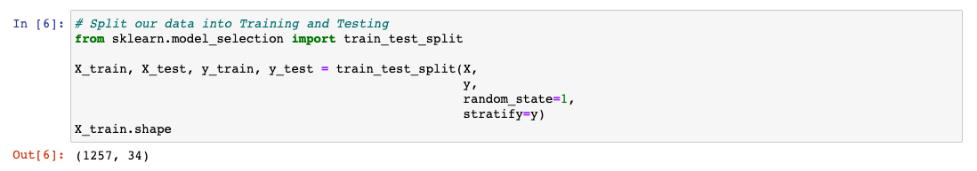
Splitting the Data
Description of how data was split into training and testing sets:
Import train_test_split from sklearn > The train_test_split function of the sklearn. model_selection package in Python splits arrays or matrices into random subsets for train and test data
Create X and y training and testing variables
Use train_test_split code to assign values to the variables as seen below

Slide 22
Database

Slide 23
Database Requirements
We’ve created a fully integrated PostgreSQL database + have met the following requirements:
Database stores static data for use during the project: full_data table
Database interfaces with the project: data is separated + joined into tables and then connected to the ML model with a SQLAlchemy connection string
Database includes at least two tables: basic_personal_information, employee_current_job, employee_feedback, employee_finances, employee_satisfaction, employee_work_history, full_data
Database includes at least one join using SQL: See Database splits joins .sql file
Database includes at least one connection string: using SQLAlchemy: ML_Model_Draft2.ipynb file
Presentation includes an ERD with relationships: see QuickDBD-export.png file

Slide 24
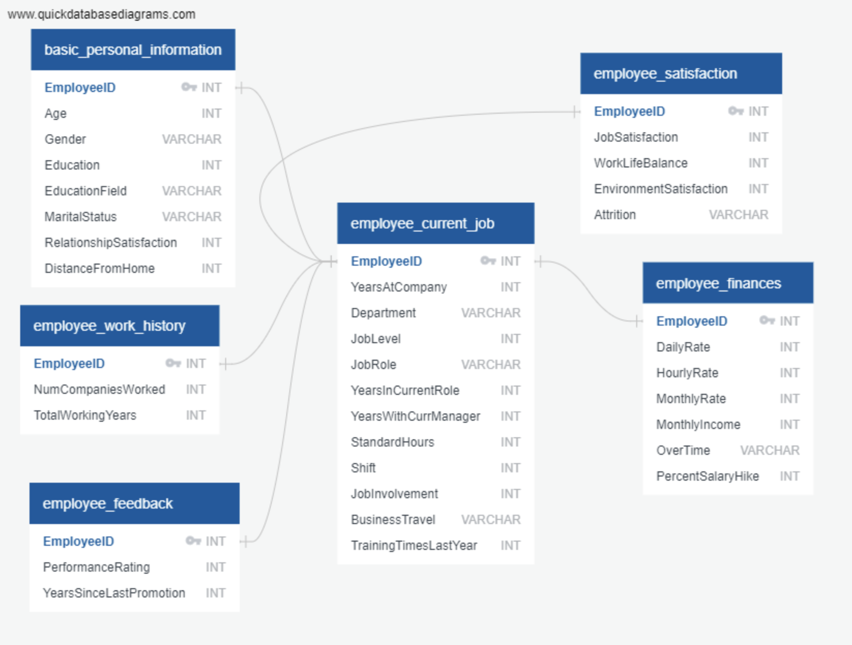
ERD Visual

Slide 25
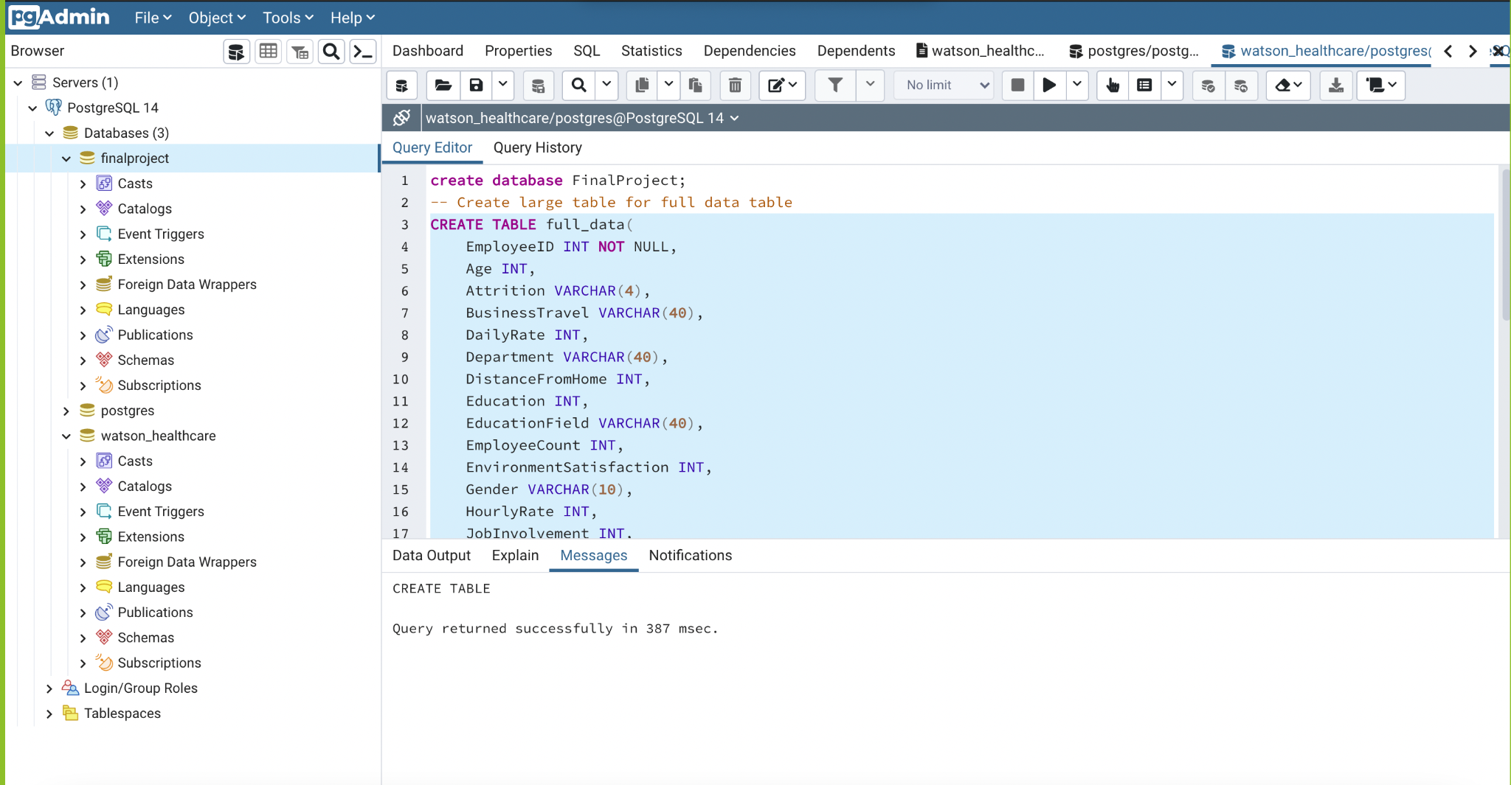
Database Visual:
PostgreSQL DB Creation in PgAdmin

Slide 26
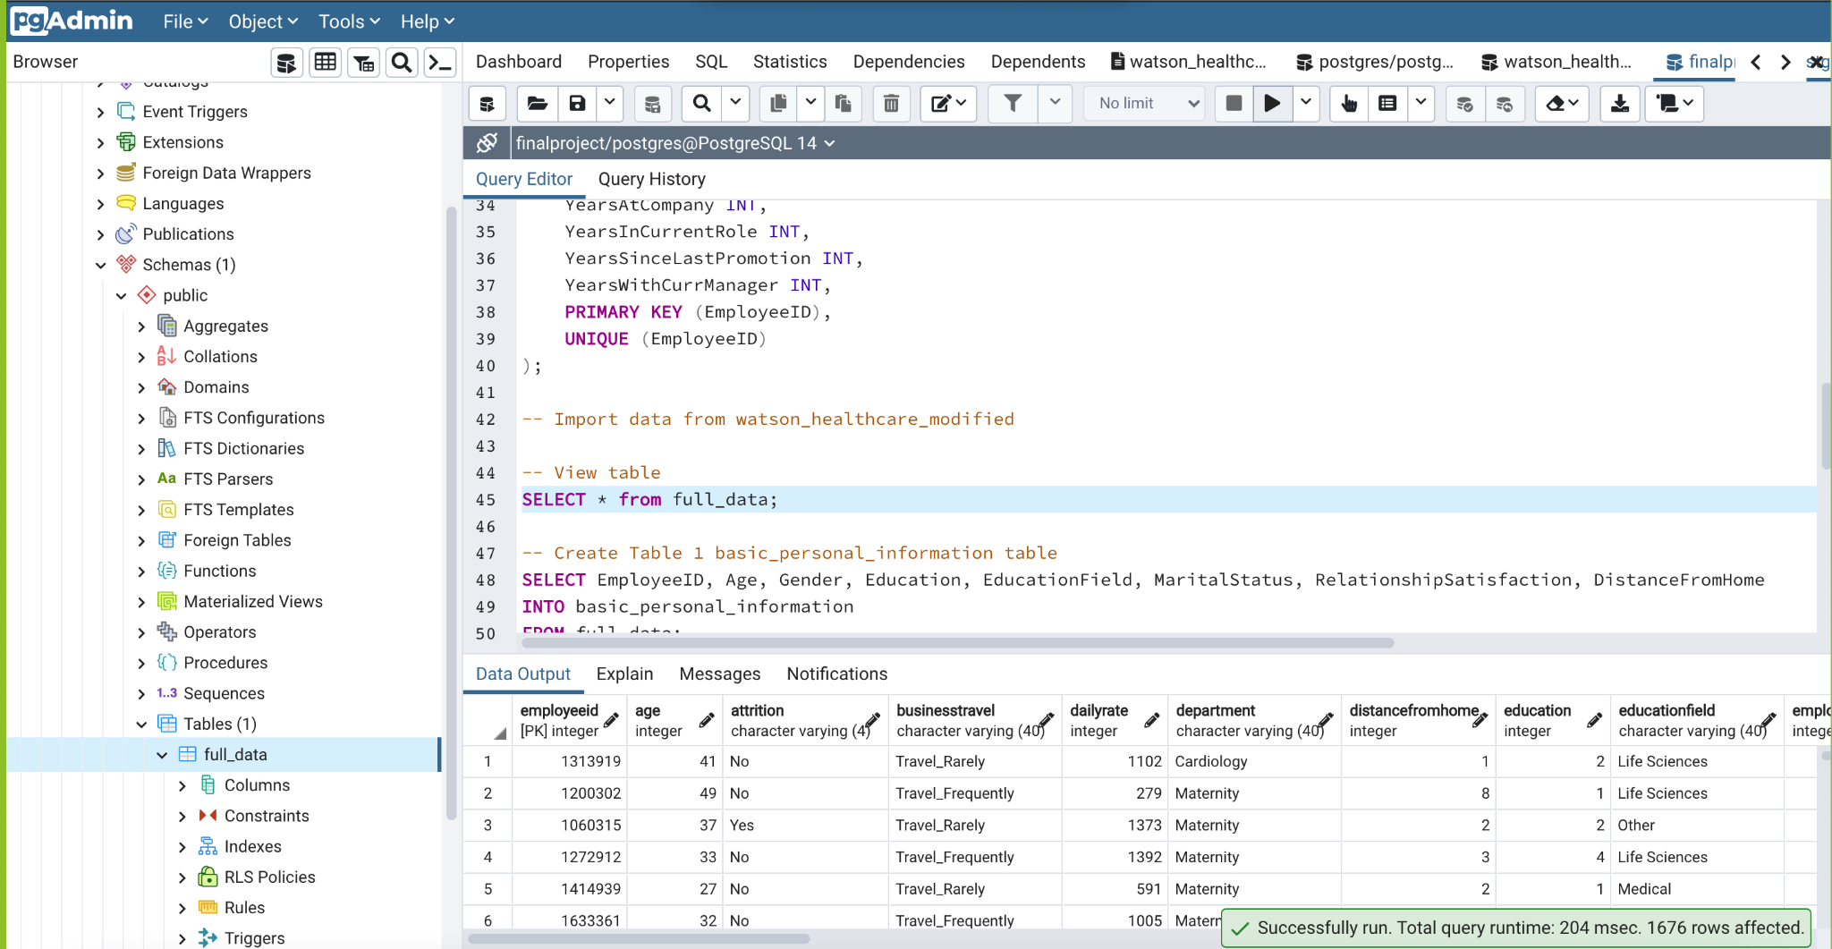
Database Visual:
Create main table with all data

Slide 27
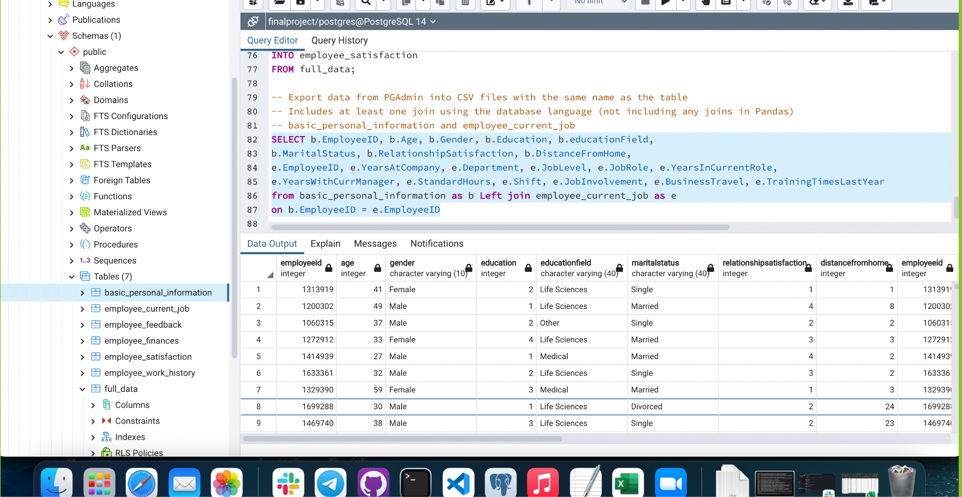
Database Visual:
Create 1 join using SQL to combine 2 tables

Slide 28
Dashboard

Slide 29

Dashboard Outline
Storyboard on a Google Slide(s):
The storyboard, displayed in the next slide, outlines our Tableau dashboard, which will visualize the answers to 1. who is most likely to attrit, 2. when are they most likely to attrit, and 3. why they are most likely to attrit.
Description of the tool(s) that will be used to create the final dashboard:
The final dashboard will be created using multiple graph types in Tableau. These graphs will help visualize which factors most heavily influence a person’s likelihood of attritting, and the typical profile of a healthcare worker who is likely to attrit.
Description of interactive element(s):
We will incorporate interactive elements into the graphs by toggling between male and female filters to show the difference in attrition data by gender.

Slide 30
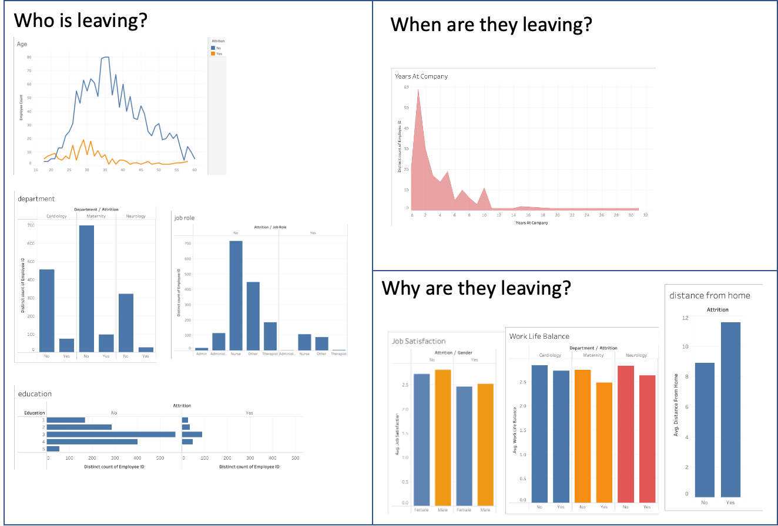
Storyboard: Attrition in Health Care

Slide 31
Appendix/Rubric Slides

Slide 32
Section 1

Slide 33
Presentation
Content
Team members have drafted their project, including the following:
✓ Selected topic: Predicting employee attrition in the healthcare industry
✓ Reason why they selected their topic: The COVID pandemic put intense strain on the healthcare industry and led to unprecedented levels of attrition. Being able to predict which employees will attrit can help hospitals prepare for tighter staffing and lessen the impact to their patients and their bottom line. In short, this topic is very relevant and applicable to the current challenges faced in this industry.
✓ Description of their source of data: The synthetic data we’re using is based on the IBM Watson dataset for attrition.
✓ Questions they hope to answer with the data: We hope to understand 1. which factors most heavily influence a person’s likelihood of attritting and 2. the typical profile of a healthcare worker who is likely to attrit.
Note: The content does not yet need to be in the form of a presentation; text in the README.md works as well.

Slide 34
GitHub
Main Branch
✓ Includes a README.md
README.md must include:
✓ Description of the communication protocols
Individual Branches
✓ At least one branch for each team member
✓ Each team member has at least four commits from the duration of the first segment
Note: The descriptions and explanations required in all other project deliverables should also be in your README.md as part of your outline, unless otherwise noted.

Slide 35
Machine Learning Model
Team members present a provisional machine learning model that stands in for the final machine learning model and accomplishes the following:
✓ Takes in data in from the provisional database
✓ Outputs label(s) for input data

Slide 36
Database
Team members present a provisional database that stands in for the final database and accomplishes the following:
✓ Sample data that mimics the expected final database structure or schema
✓ Draft machine learning module is connected to the provisional database

Slide 37
Dashboard
n/a

Slide 38
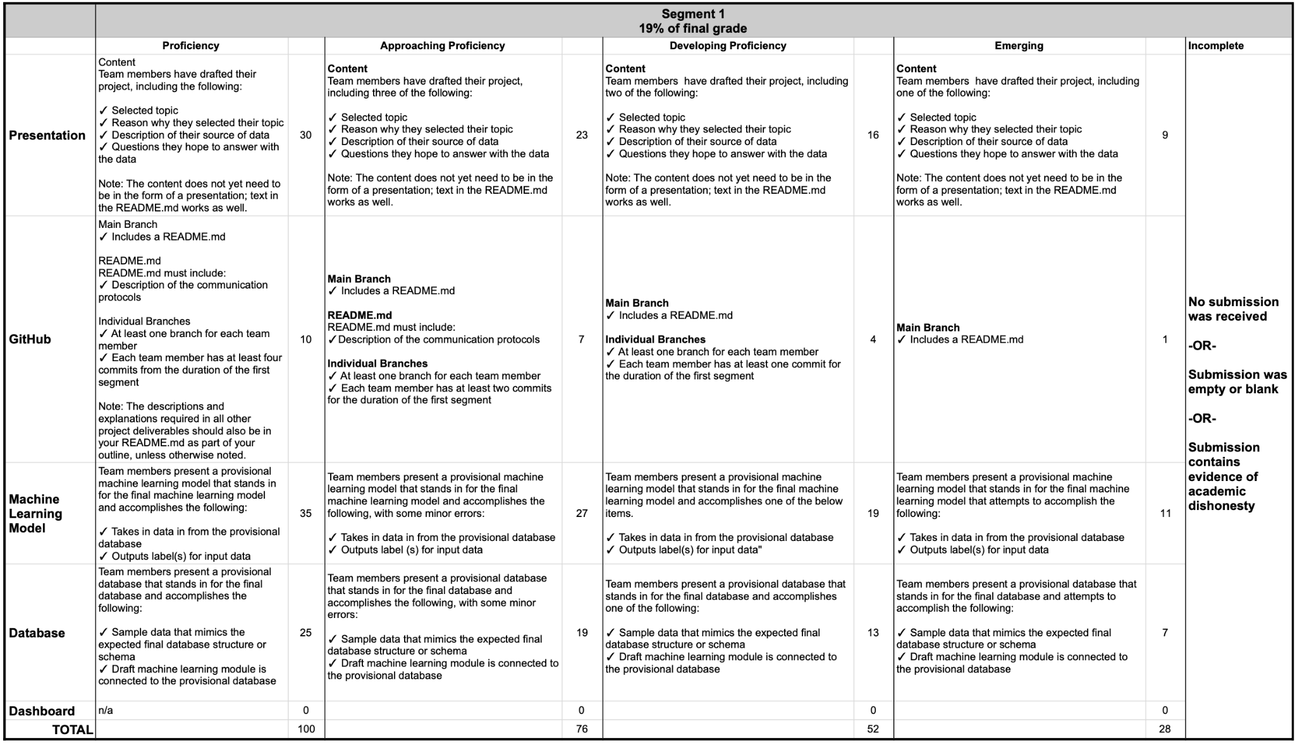

Slide 39
Section 2

Slide 40
Presentation (15 pts)
Content: The presentation outlines the project, including the following:
Selected topic
Reason topic was selected
Description of the source of data
Questions the team hopes to answer with the data
Description of the data exploration phase of the project
Description of the analysis phase of the project
Slides: Presentations are drafted in Google Slides.

Slide 41
GitHub (10 pts)
Main Branch
All code in the main branch is production-ready.
The main branch should include:
All code necessary to perform exploratory analysis
Some code necessary to complete the machine learning portion of project
README.md should include:
Description of the communication protocols
Outline of the project (this may include images, but they should be easy to follow and digest)
Individual Branches
At least one branch for each team member
Each team member has at least four commits for the duration of the second segment (eight total commits per person)

Slide 42
Machine Learning Model (30 pts)
The team members are expected to submit the code for the machine learning model, as well as the following:
Description of preliminary data preprocessing
Description of preliminary feature engineering and preliminary feature selection, including the decision-making process
Description of how data was split into training and testing sets
Explanation of model choice, including limitations and benefits

Slide 43
Database (30 pts)
The team members are expected to present a fully integrated database, including the following:
Database stores static data for use during the project
Database interfaces with the project in some format (e.g., scraping updates the database)
Includes at least two tables (or collections, if using MongoDB)
Includes at least one connection string (using SQLAlchemy or PyMongo)
Includes at least one join using the database language (not including any joins in Pandas)
IMPORTANT: If you use a SQL database, you must provide your ERD with relationships.

Slide 44
Dashboard (15 pts)
A blueprint for the dashboard is created and includes all of the following:
Storyboard on a Google Slide(s)
Description of the tool(s) that will be used to create the final dashboard
Description of interactive element(s)

Slide 45
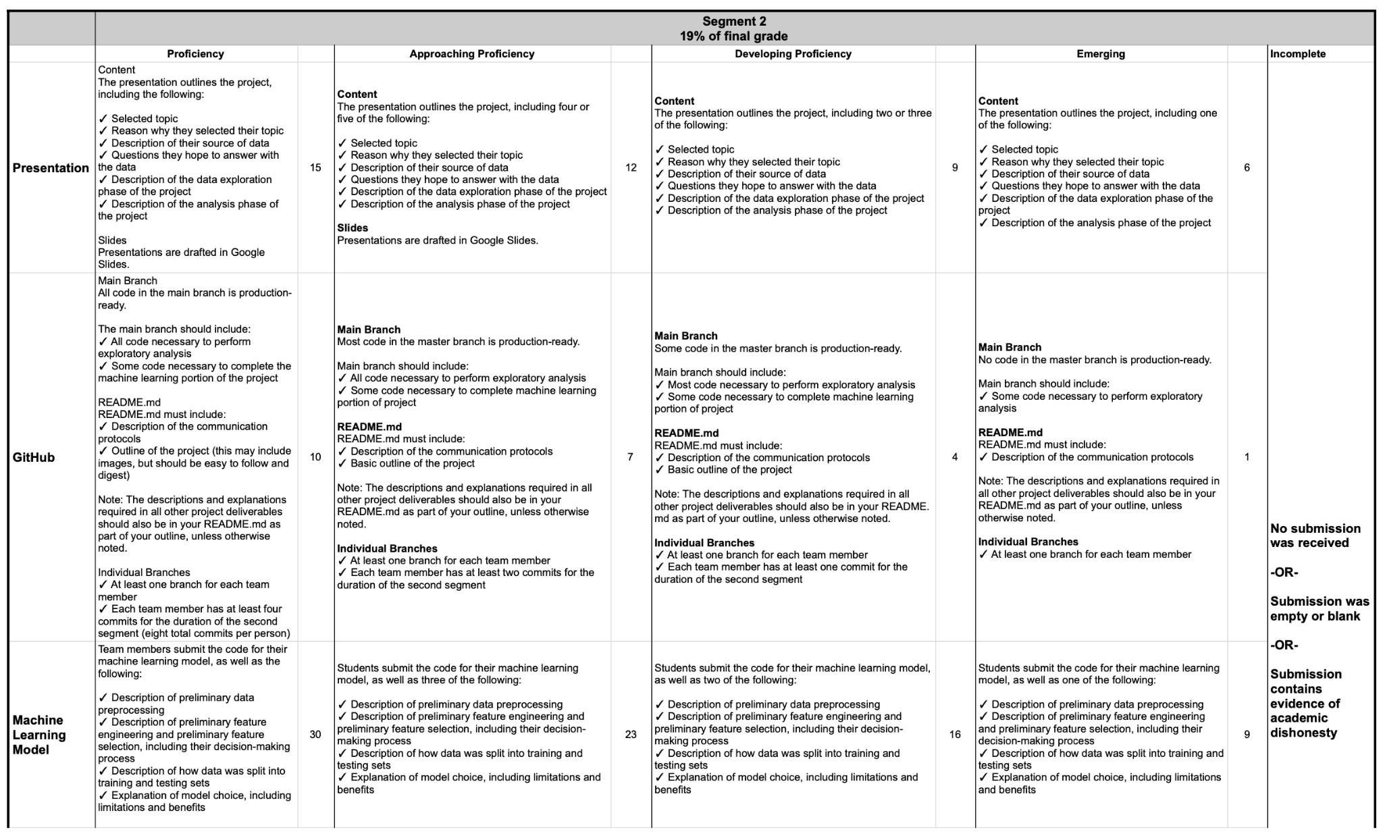

Slide 46
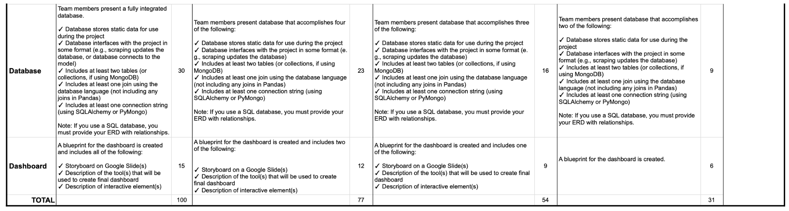

Slide 47
Section 3

Slide 48
Presentation (15 pts)
Content: The presentation tells a story about the project and includes the following:
Selected topic
Reason topic was selected
Description of the source of data
Questions the team hopes to answer with the data
Description of the data exploration phase of the project
Description of the analysis phase of the project
Technologies, languages, tools, and algorithms used throughout the project
Slides
Presentations are drafted in Google Slides.

Slide 49
GitHub Repository (10 pts)
Main Branch: All code in the main branch is production-ready.
Main branch should include:
All code necessary to perform exploratory analysis
Most code necessary to complete the machine learning portion of the project
README.md should include:
Description of the communication protocols has been removed
Cohesive, structured outline of the project (this may include images, but they should be easy to follow and digest)
Link to Google Slides draft presentation
Individual Branches- Requirements for the individual branches follow:
At least one branch for each team member
Each team member has at least four commits for the duration of the third segment (12 total commits per person)
IMPORTANT: The descriptions and explanations required in the project deliverables should also be in your README.md as part of your outline, unless otherwise noted.

Slide 50
Machine Learning Model (45 pts)
Students will be expected to submit the working code for their machine learning model, as well as the following:
Description of data preprocessing
Description of feature engineering and the feature selection, including the decision-making process
Description of how data was split into training and testing sets
Explanation of model choice, including limitations and benefits
Explanation of changes in model choice (if changes occurred between the Segment 2 and Segment 3 deliverables)
Description of how they have trained the model thus far, and any additional training that will take place
Description of current accuracy score
Additionally, the model obviously addresses the question or problem the team is solving.

Slide 51
Database (0 pts)
There are no deliverables for the database integration section of the project for this segment.

Slide 52
Dashboard (30 pts)
The dashboard presents a data story that is logical and easy to follow for someone unfamiliar with the topic. It includes the following:
Images from the initial analysis
Data (images or report) from the machine learning task
At least one interactive element

Slide 53
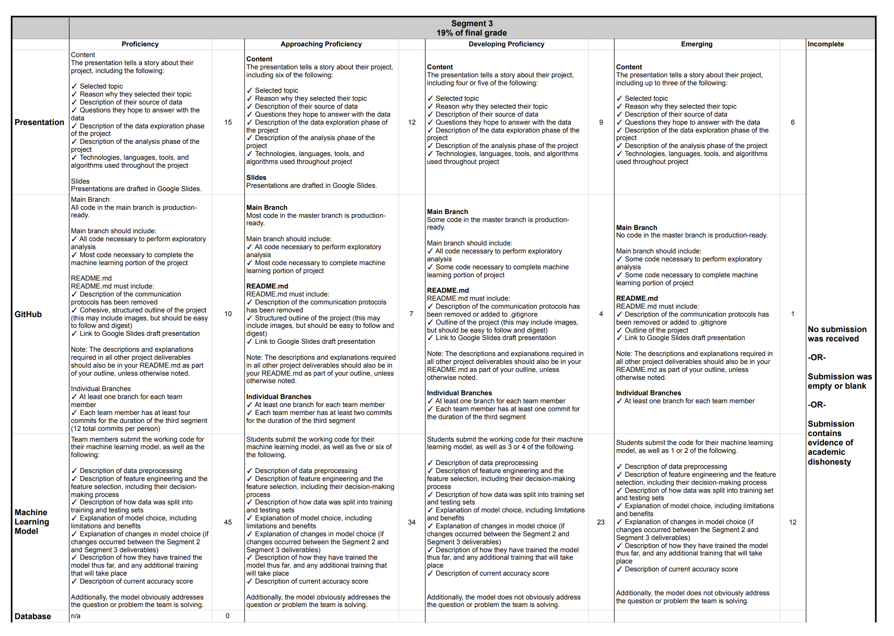

Slide 54
